Slide 1


SM Weather Information
Presented by:
Santhosh Reddy Yellala
Mukta Hanumanthu
Instructor:
Dr. Long-Zhuang Li

Slide 2


Introduction
Provides information of weather details at particular city.
It shows Current weather data, Air pollution, Recommendations and Astronomy of city.

Slide 3
Data Sources
SM Weather Information
www.openweather.com
www.sunrise-sunset.org
www.breezometer.com

Slide 4
Local Schema – Openweather – S1 Attributes
coord.lon
coord.lat
weather.main
weather.description
main.temperature
main.pressure
main.humidity
main.temp_min
main.temp_max
wind.speed
wind.deg

Slide 5
Local Schema – Breezometer – S2 Attributes
dominant_pollutant_canonical_name
dominant_pollutant_description
random_recommendations

Slide 6
Local Schema – Sunrise-Sunset – S3 Attributes
obj.sunrise
obj.sunset
obj.uv
obj.elevAngle
obj.hAngle

Slide 7
Local Schema summary
S1(coord.lon, coord.lat, weather.main, weather.description, main.temperature, main.pressure, main.humidity, main.temp_min, main.temp_max, wind.speed, wind.deg)
S2(dominant_pollutant_canonical_name, dominant_pollutant_description, random_recommendations)
S3 (obj.sunrise, obj.sunset, obj.uv, obj.elevAngle, obj.hAngle)

Slide 8
Global Schema
weather (weather, description, temperature, Humidity, max_temparature, min_temparature, wind_speed, wind_direction, dom_pollutant, air_quality, recommendations, sunrise, sunset, uv, elevAngle, hAngle)

Slide 9
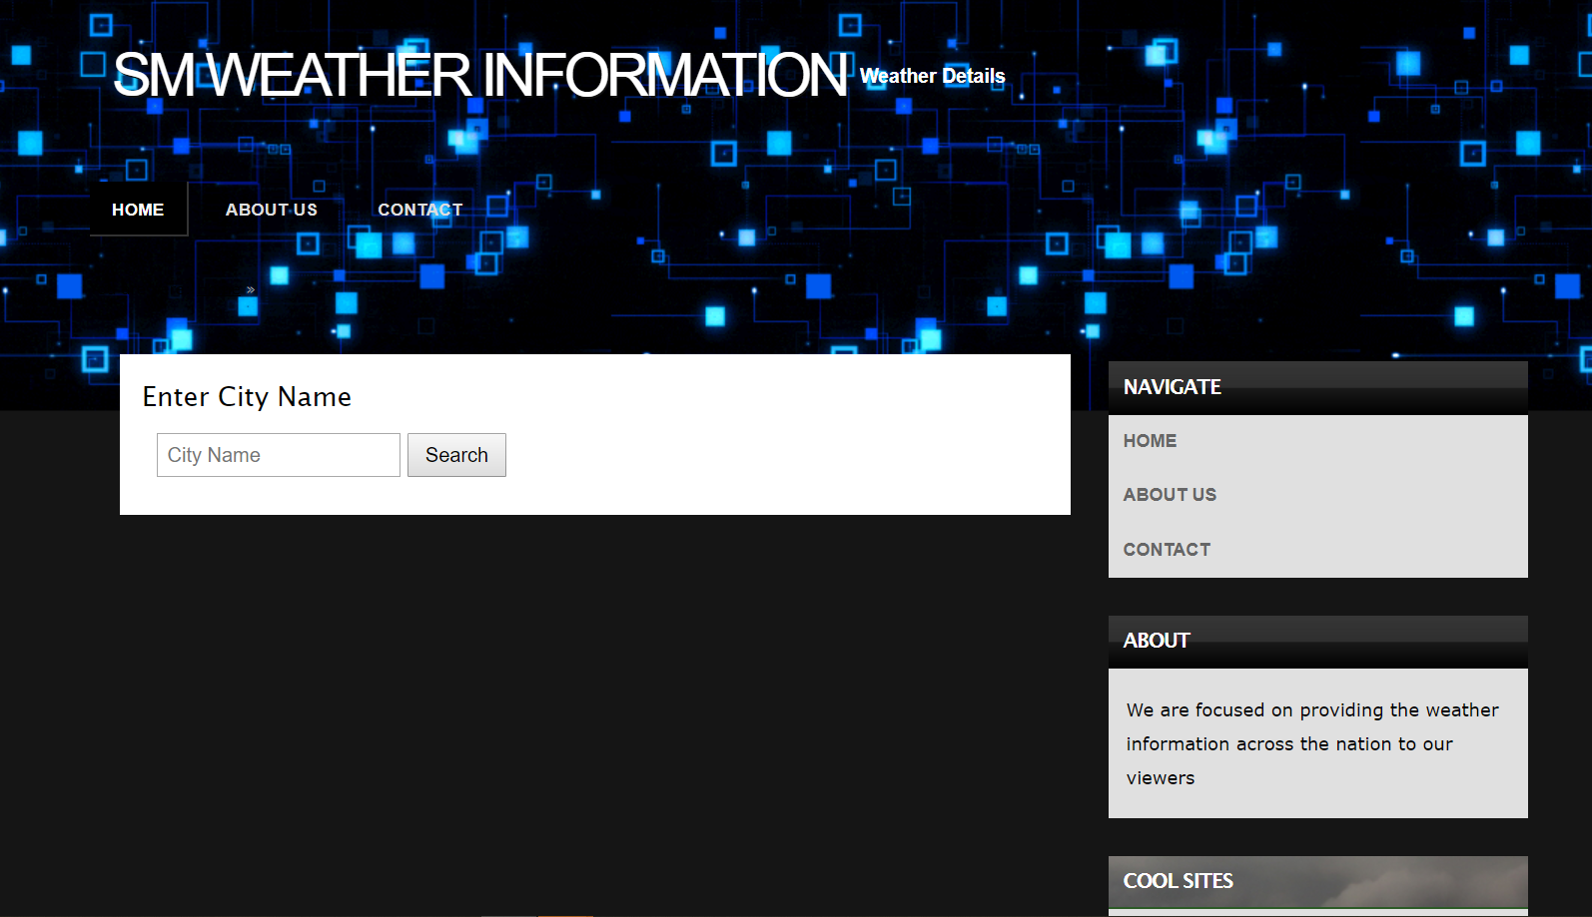
Demonstration

Slide 10
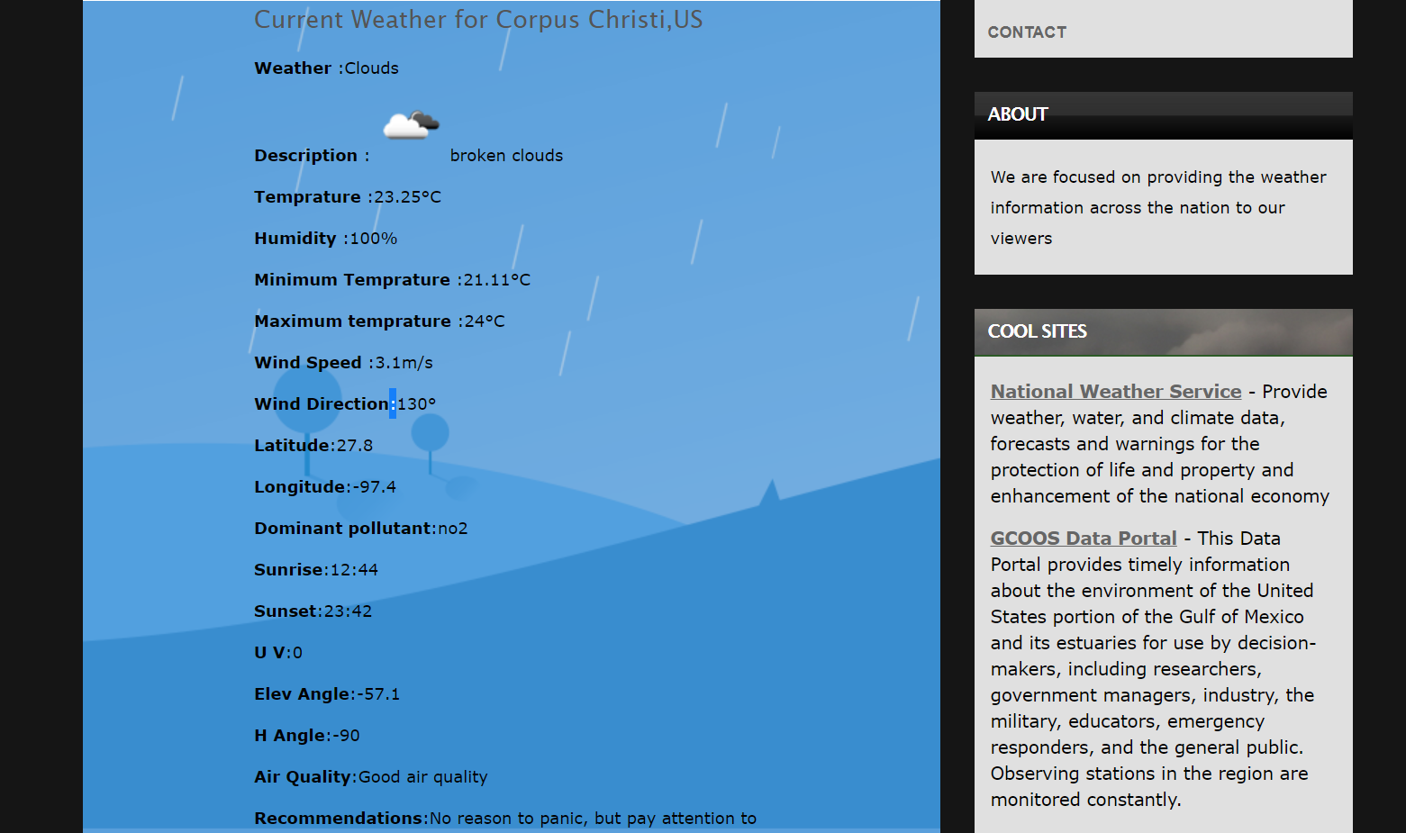
Demonstration

Slide 11
Thank You!

